Slide 1


SQL vs NoSQL
José Alberto Benítez-Andrades, Ph.D. – jbena@unileon.es
Assistant Professor
Universidad de León
Notes:
Good morning everyone, first of all, I would like to thank Deveeshree for inviting me to give these seminars, it is a pleasure for me. It is a pleasure to collaborate with the University of Washington, U DAB.
I apologise for my level of English, this is Spain and the education system I studied in was not very good for learning languages.
And I thank you for attending my seminar at such an early hour for you.
In my talk today I am going to talk about SQL and NoSQL, relational and non-relational databases.
First of all, I would like to introduce myself briefly. As Deveeshree rightly said, I have been teaching and researching at the University of León for a few years now. I finished my PhD thesis in 2017 and I have been working full time since 2018. Previously I have worked in the private sector, in different companies, related to IT, more specifically performing system administration and web application programming tasks.

Slide 2

Who is Prof. Benítez?

Slide 3

About me
Academic background:
Computer Engineer (06/10)
Computer Languages and Systems (10/13)
Ph.D Computer and Production Engineering (13/17)
Master's Degree in Data Science and Engineering (19/?)
Work experience:
XyOn-Servers S.L.U. (02/06)
INDRA Sistemas S.A. (09/10)
LHC Studios Kaplan S.L. (08/10)
INDIPROWEB S.L. (10/Hoy)
Weblogs S.L. (13/16)
A part time instructor (13/18)
Teaching Assistant(18/20)
Assistant Professor (20/Today)

Slide 4
SALBIS & SECOMUCI Research groups
SALBIS - SAlud Bienestar Ingeniería y Sostenibilidad Sociosanitaria
HWESHCS - Health Well-being Engineering and Social and Health Care Sustainability
13 members + 10 associate researchers
Multidisciplinar, inter-university and international.
Research lines:
Personnel policy, performance, community well-being and healthy habits in children and young people.
Networks and health: social network analysis applied to organizational behavior and health habits.
Emotional Intelligence and Health: Community Assessment and Interventions
www.salbis.es
Notes:
On the research side, I belong to a research group called SALBIS in english....
We are 13 members and 10 associate researchers.
We are a multidisciplinar, inter-univeristy and international research group
Our research lines are....

Slide 5

SALBIS & SECOMUCI Research groups
SECOMUCI - SEguridad y COnocimiento en el MUndo CIbernético
SAKCYWO - SAfety and Knowledge in the CYbernitc WOrld
7 members + 5 associate researchers
Information Security, Communications Network Security, Internet Security of Things, Software Defined Networks, Modeling of Knowledge Applied to Health with Social Network Analysis Techniques, Artificial Intelligence, Expert Systems, Multiagent Systems, Automatic Learning and Big Data applied to the fields of Education, Security and Health.
Notes:
But, We work together with another research group.

Slide 6



Who is José Alberto?
Mis hobbies:
Notes:
I also like to point out that I am not only involved in research and teaching, but that I also have a life and, in my case, I really enjoy physical activity. I enjoy running, trail running<, powerlifting, weightlifting, and Spartan Race-style obstacle courses.
I also have a very nice cat, or rather, I live with a cat who allows me to occupy part of his living space, his name is Lyu.

Slide 7

SQL vs NoSQL
Notes:
And now we are going to talk about databases-

Slide 8
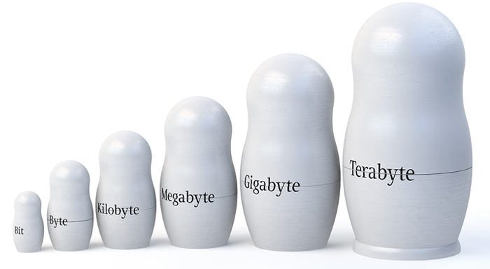
RDBMS (SQL) vs NoSQL
Notes:
Nowadays, as time goes by, the need to store data is increasing more and more. Proof of this is that since the appearance of the minimum unit of programming, the byte, the units of measurement of storage that we use even in domestic and professional environments are increasing more and more every day: KB, MB, GB, TB, PB...
This need to store so much data also translates into an increased demand for requests for some of that data from users/apis interacting with a software. And as a consequence: we need better servers, bigger and faster storage units, better transfer speeds, etc.

Slide 9
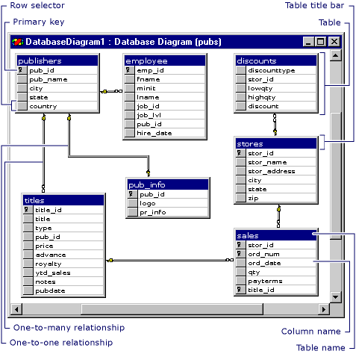
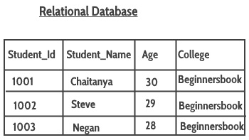
RDBMS (SQL) vs NoSQL
RDBMS = Relational Database Management System
SQL = Structured Query Language
Notes:
The language we use in RDBMSs is known as "SQL".
Some examples of this databases that use SQL are: Oracle, Microsoft SQL Server, MySQL, MySQL Workbench, PostgreSQL, etc.
An example of a diagram of such a DB could be:
In this image we can see a database composed by seven tables.
Within these tables we can see one or more fields that are part of what is known as primary key. The primary key allows us to differentiate each element found within a table, it is a unique identifier. The primary key would be equivalent to our identity number, in Spain what we know as NIF or DNI.
In such a database, relationships may exist between different tables. For example, here we see how there is a relationship between the publishers table and a table called "pub_info" which contains the logo and other added information.
We can also see how it is possible to relate a table dedicated to the sales made, in which the shop identifier, the order number and the title of the book that has been sold are stored. These three fields make up what is known as the primary key, i.e. no two orders can have the same shop identifier, the same order number and the same book title, all at the same time.
An example of a SQL table could be this one.
It stores a student identifier, the student's name, age and the institution to which the student belongs.

Slide 10
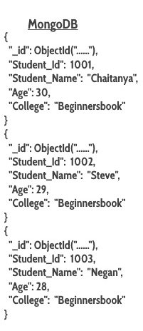
RDBMS (SQL) vs NoSQL
NoSQL = Not Only SQL
Notes:
On the other hand, we have what are known as non-relational databases, or "Not Only SQL".
Some examples of NoSQL are: Cassandra, Redis, HBase, MongoDB, CouchDB.
An example, based on the same data as in the table above, could be:

Slide 11
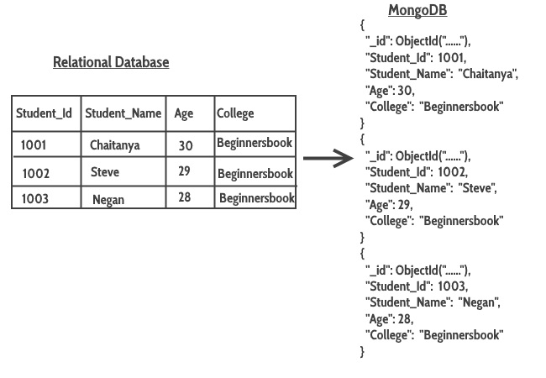
RDBMS (SQL) vs NoSQL
Differences.
Notes:
If we look at both ways, both ways will allow us to store the same information on a database (DB). But, although there are many differences between both databases, if we look at the two tables:
We can see that the main difference between the two lies in how the data is structured/stored.
Although with this difference we have only just started, in this case, revealing the main difference between both databases, there are many more, and we are going to go into detail about most of the differences between RDBMSvs NoSQL in order to choose the best one for each of our projects.
Choosing one technology or another will be decisive when it comes to scaling (scaling = capacity of a system to grow in magnitude) the performance of our DB. Therefore, it is necessary to analyse in detail the needs that we believe we have now and in the future in order to choose one type of database or another.
It should be noted that, if we have a small-scale personal project, we will not notice much difference between using one or the other, because in a small-scale project either of the two databases will be very fast due to their small size and low usage. On the other hand, the differences between two database systems are aggravated when we have a medium or large-scale project due to the fact that the demand for data, both in terms of reading and writing, and the complexity of the database is usually greater.

Slide 12
RDBMS (SQL) vs NoSQL
SQL vs NoSQL Which type of database is better?
Notes:
SQL vs NoSQL Which type of database is better?
There is no one type of database that is better or worse than the other, rather, as we have already seen above, both databases are different, but in both we have been able to store the same data in different ways. Both databases are fast alternatives that offer different performances depending on the objectives of our project. Both databases store data, in the example:
It will be up to us to find out which one suits us best by analysing in detail the needs and the pros and cons of both types of databases. Therefore, we are going to delve once and for all into their differences.

Slide 13
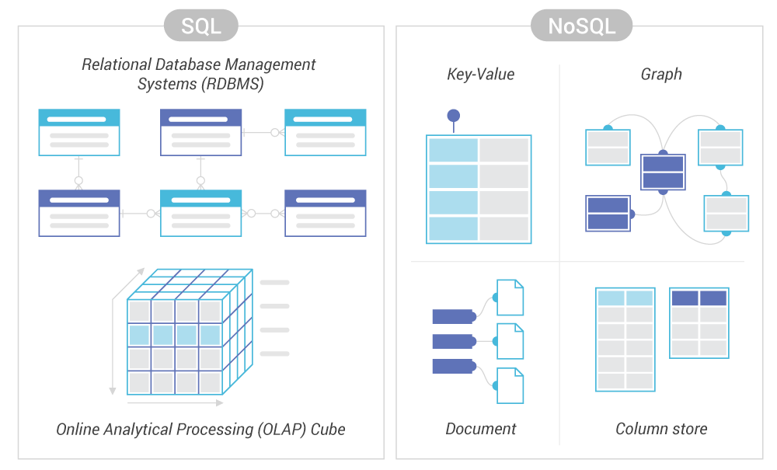
RDBMS (SQL) vs NoSQL
Structure/Model
Notes:
Differences between SQL vs NoSQL
Firstable we can see differences between the structure or model:
SQL databases are relational and have fixed schemas, whereas NoSQL databases do not require a fixed schema system and are more dynamic. SQL databases can be joined by means of a JOIN, whereas NoSQL databases "do not allow the use of JOINs" or they are very limited (hence the name, what we have talked about before, that some call them NoREL NoSQL of non-relational)..
In this image we can see how RDBMSs have a very clear and defined schema, while NoSQLs can be of several types.

Slide 14
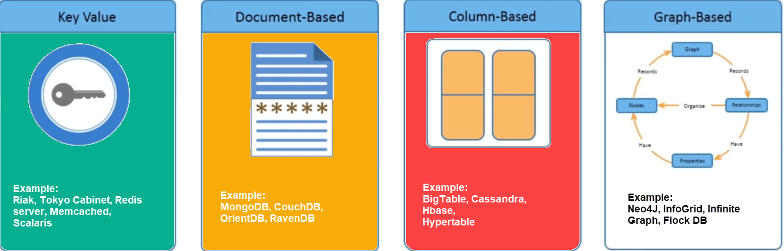
RDBMS (SQL) vs NoSQL
Structure/Model
Notes:
Differences between SQL vs NoSQL
Firstable we can see differences between the structure or model:
SQL DBs are structured in tables, while NoSQL DBs can be based on: documents, key-value, graphs or wide-column store.

Slide 15
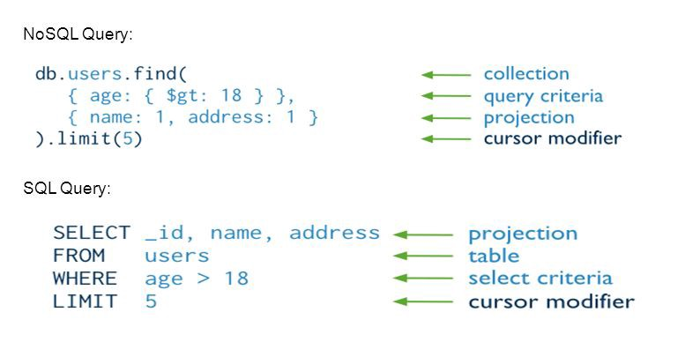
RDBMS (SQL) vs NoSQL
Language
Notes:
Other difference between SQL and NoSQL is the language:
- SQL databases define and use a structured query language (SQL) that is tremendously powerful. This makes it a perfect candidate and a safe choice especially when queries are large and complex. At the same time, however, this language can be quite restrictive. In addition, SQL requires you to use predefined schemas (defined in advance) to determine the structure of your data before working with it. All your data must follow the same structure. This, as we have already discussed above in its structure (static schema), may require a lot of time to be spent in its initial phase in the preparation and analysis of the requirements when building the database, as a change in the structure would be difficult and detrimental to the whole system.
- A NoSQL database has a dynamic schema for unstructured data. Data is stored in many ways (document-oriented, column-oriented, graph-oriented or organised as a KeyValue store) this flexibility means that documents can be created without having a defined structure first. In addition, each document can have its own unique structure. The syntax varies from database to database, and you can add fields on the fly. That is, new fields can be added/added to an already defined document without any problem.
- SQL is ideal for complex queries, while NoSQL is not so good for complex queries. But they are ideal for simple queries.
- So SQL has well-defined standards, while NoSQL does not.

Slide 16
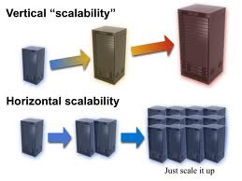
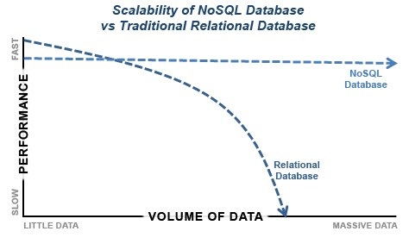
RDBMS (SQL) vs NoSQL
Scalability
Notes:
Scalability:
SQL databases, when faced with an increase in requests, scale vertically (improve the power of our server to obtain better results) whereas NoSQL databases scale horizontally (add/distribute the database to more servers to obtain better results). To better understand the concept of scalability, let's take a look at the following image:
By fragmenting more traffic through horizontal scalability, we can more easily add servers than by upgrading the server with new hardware. A clear example is, assuming the servers are buildings, if we talk about a need for more people in that block, it will be much easier to add floors on top of it (horizontal scalability) than to create a larger block of floors (vertical scalability). This issue is quite important because, if there is an increase in requests, scalability in a DB, translates into an economic cost and horizontal scalability will always be easier to do and cheaper. Therefore, server maintenance is cheaper in NoSQL. And it will always be better to install new operational nodes (servers) to balance the workload (horizontal growth) than to use vertical growth as it will be less costly to scale.

Slide 17
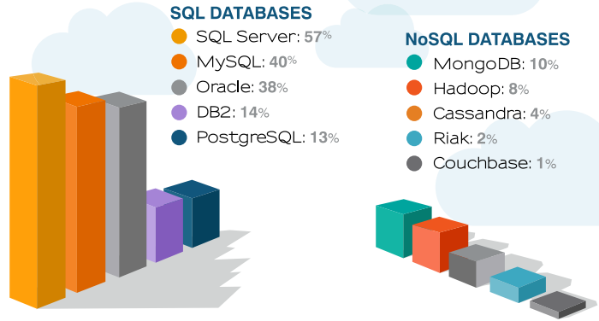
RDBMS (SQL) vs NoSQL
Consolidation and Support
Notes:
Support:
SQL databases and RDBMS tools are comparatively more mature than NoSQL. In addition, SQL DB vendors usually provide great support. It should also be noted that we have a lot of resources available to solve our doubts, as many of these problems have already been solved by the community, since they are databases that have been with us for a longer period of time.
On the other hand, NoSQL databases, being a less mature database, do not offer as much reliability and therefore do not yet offer enough guarantees or confidence for the developer community to fully trust them. Moreover, as they are more recent databases, there are fewer experts in this type of databases, especially when it comes to implementing a NoSQL database on a large scale.
NoSQLs are usually OpenSource, while some SQLs are half open-source and some are even closed-source (Oracle is an example).
This image talks about the business use of SQL vs. NoSQL databases and although I don't know what year the image is about or what data it is based on. It perfectly narrates what we have just discussed, that maturity is trust at an enterprise level. Although big companies like Google, Instagram, Facebook are changing this trend.

Slide 18
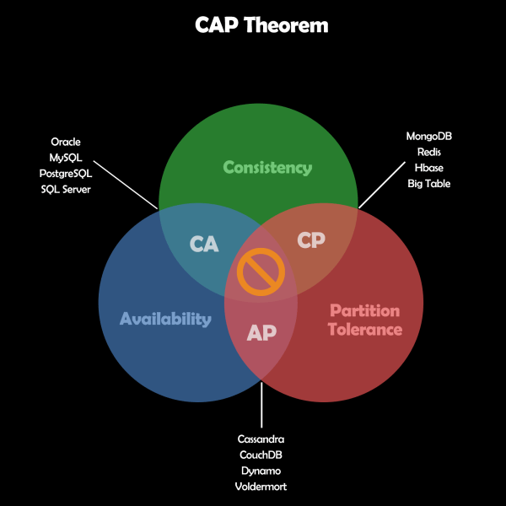
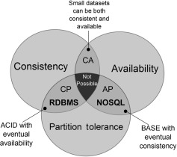
RDBMS (SQL) vs NoSQL
Performance
vs
Security
Notes:
Performance vs security
- As we have seen in previous points, by avoiding joins as much as possible, NoSQL databases have fewer relationships, and no JOINs. On the other hand, SQL databases have to "stitch" the data of several tables when making queries. So they are faster, the NoSQL ones.
- Another concept that directly affects the performance and on which it is essential to stop to better understand the difference in performance between both databases is the concept of the CAP Theorem. CLICK
CAP = Consistency, Availibility and Partition Tolerance
If we look at this theorem we find 3 circles. Let's explain them:
- Consistency: it means that clients see the same version of the data.
- Availibility: all clients can access some version of the data.
Partition Tolerance: The data can be partitioned in several servers and if one of them goes down, the system continues working.
In this theorem there is a concept called "Pick two" which means that we will have to choose 2 of the 3 protagonists, which always means giving up something. That is to say, in the case of NoSQL they choose between:
Tolerance and Availability: Cassandra, CouchDB, Dynamo, Voldermort, etc.
Tolerance and Consistency: MongoDB, Redis, Hbase, Big table, etc.
In the case of SQL DBs they choose:
Consistency and Availability: Oracle, MySQL, PostgreSQL, SQL Server, etc.
In this image, we can see where RDBMS and NoSQL are placed in a more visual way CLICK:

Slide 19
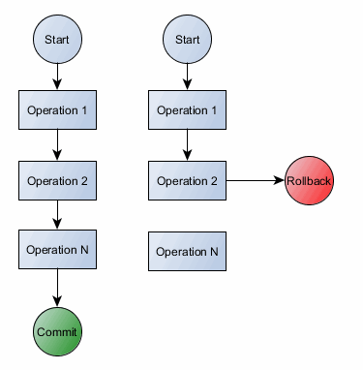
RDBMS (SQL) vs NoSQL
ACID = Atomicity, Consistency, Isolation and Durability
Performance
vs
Security
Notes:
Performance vs security
Another concept on which it is essential to dwell in order to better understand its performance is that of ACID vs BASE vs CAP:
ACID: aims to guarantee transactions, even if this means lower performance. It is the one used by RDBMS (SQL).
ACID = Atomicity, Consistency, Isolation and Durability = Atomicidad, Consistencia, Aislamiento, Durabilidad
An example of ACID could be a bank transfer that requires several transactions and cannot fail. In the event of a failure, all transactions performed since its initiation will have to be undone.
NoSQL is not suitable for complex transactions. They do not support ACID transactions across multiple documents. In other words, they have a higher fault tolerance than SQL, which is more secure as it does focus/prioritise on ACID transactions.

Slide 20
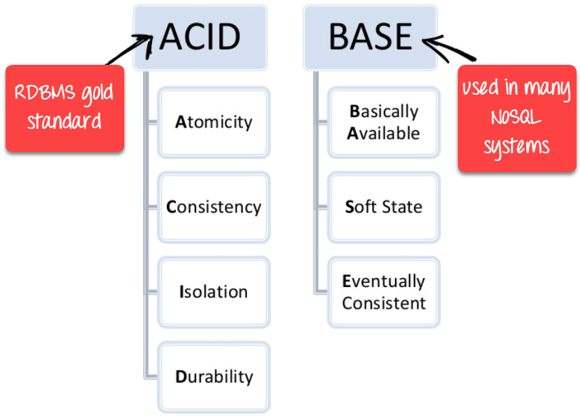
RDBMS (SQL) vs NoSQL
BASE = Basically, Available, Soft State, Eventually Consistent
Performance
vs
Security
Notes:
Performance vs security
BASE = Basically, Available, Soft State, Eventually Consistent BASE: ACID transactions guarantee the transaction, although this comes at a price that NoSQL DBs are not willing to assume. It is the cost they assume in exchange for having greater scalability and greater speed. So they are less demanding with these transaction guarantees in exchange for being faster, more resilient and easier to scale.

Slide 21
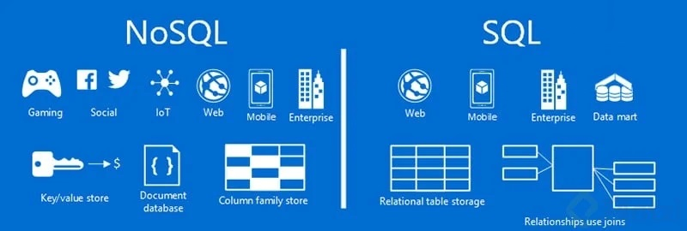
RDBMS (SQL) vs NoSQL
What type of database to use: SQL or NoSQL?
Notes:
Well, we have already seen enough differences between both databases. Now we are going to see a picture that defines for what is more optimal to use one type of database or another.
NoSQL: they are ideal for handling large volumes of data that are generated quickly, such as: games, big data, social networks like Instagram, Facebook, etc. This type of company can assume the loss of data in exchange for speed.
SQL: They are ideal for the business environment, which requires large databases with interrelated tables and guaranteed transactions, although this means a loss of speed and more costly scalability.

Slide 22
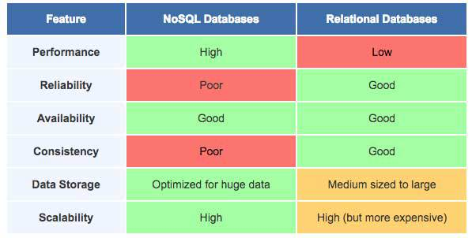
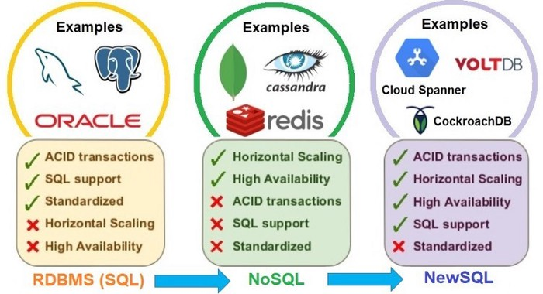
RDBMS (SQL) vs NoSQL
Finally, a brief summary
Notes:
We are going to see a comparison of the different types of databases that we can find.
The main differences between SQL and non-SQL are:
The advantages of SQL are:
Standard in relational databases.
High level language for structured data.
Easily supports highly structured queries.
Guaranteed security and better integrity.
NoSQL
Greater data handling capacity.
Cheaper server maintenance.
No fixed schema or data model.
No fixed schema or data model
In addition, I attach a comparative graph between the two databases that I found quite interesting:

Slide 23
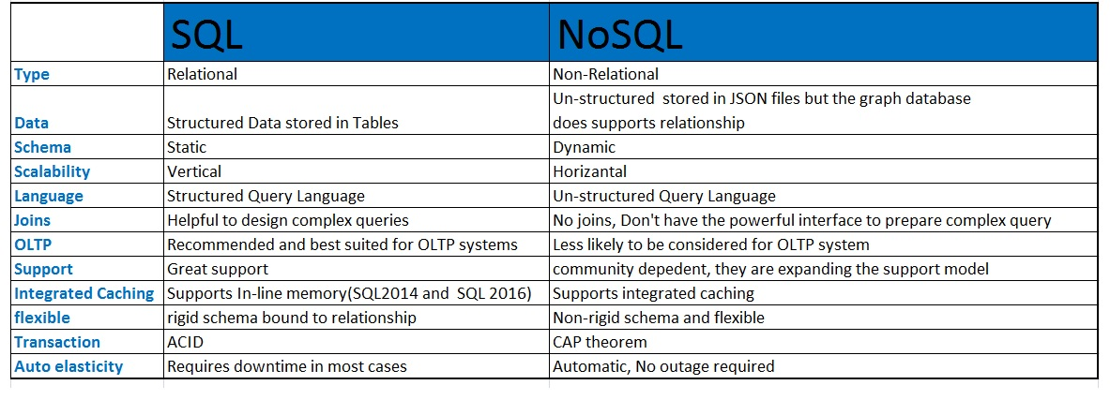
RDBMS (SQL) vs NoSQL
Notes:
Scalability:
Another concept on which it is essential to dwell in order to better understand its performance is that of ACID vs BASE vs CAP:
ACID: aims to guarantee transactions, even if this means lower performance. It is the one used by RDBMS (SQL).

Slide 24

My social networks
Mis redes:
https://www.jabenitez.com
https://www.jabefitness.com
Ig: @jabenitez88
Ig: @jabeteacher
Tw: @jabenitez88
Youtube, Linkedin, Facebook,
Researchgate…
www.salbis.es

